Slide 1
MP-2 Digital Camera Design
Nathan Thoms, Taylor Johnson, Jack Cassidy, John Lavigne

Slide 2
Challenges
Updating the wrapper
Consult wiki
Match names & bit widths
Delete & recreate

Slide 3
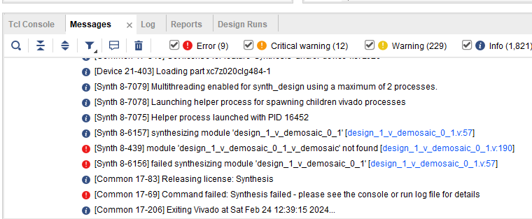
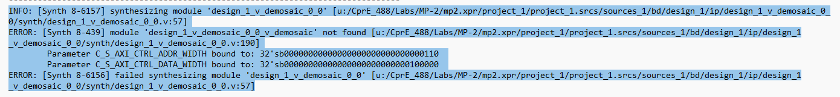
Challenges
Overthinking Modifications to camera_app.c
Hardware pipeline
Missing IP Source Files
Amount of Memory for images
Updated Iscript.ID

Slide 4
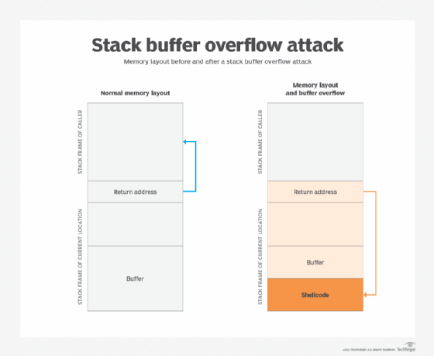
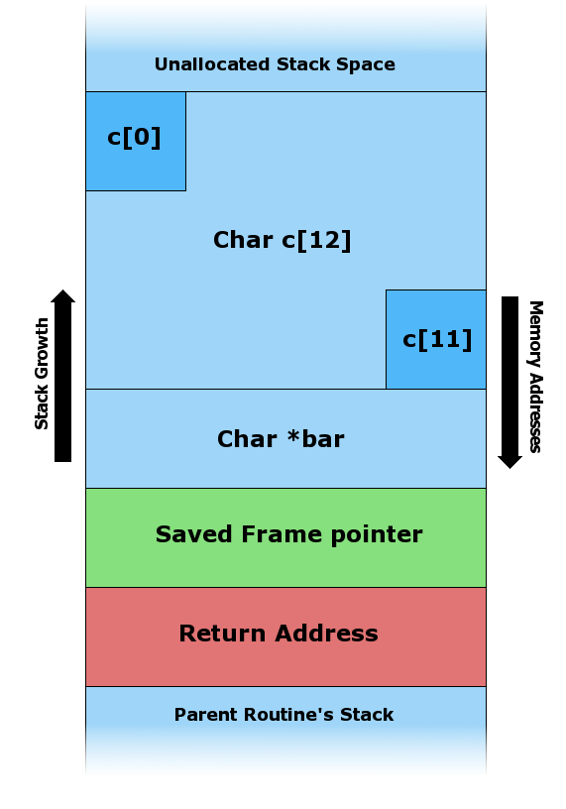
Challenges
Memory Allocation in C code
Global vs Local variables for extremely large variables
Had to debugging using assembly to find this problem
Had similar issues when working on part 7
Notes:
I didn’t have the big array that kept the bayer filter resolution be a global variable which in turn accessed memory that didn’t exist, had help from Gregory to go through assembly to see. Turns out I was getting an invalid memory access from the stack pointer, and it used roughly a MB of data for the stack:) Had similar issue when working through part 7 so I didn’t learn my lesson the first time encountering this issue. I believe its similar to the security risk covered in 308

Slide 5
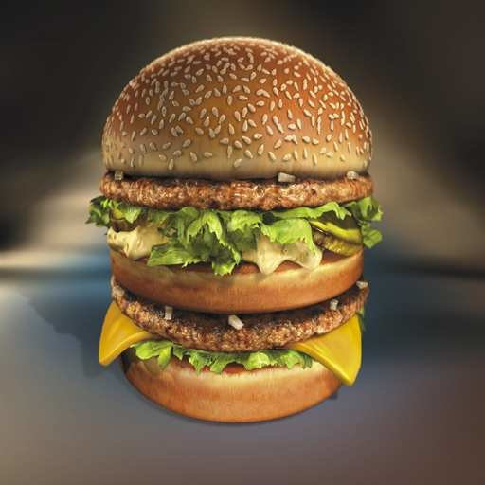
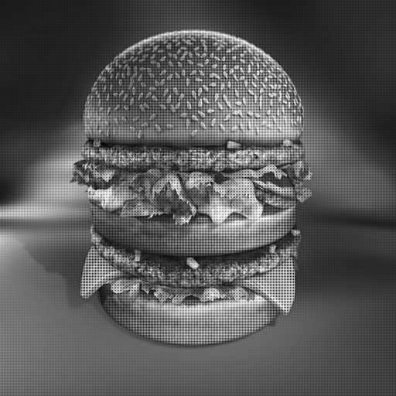

Areas of Interest
MatLab Prototyping
Excellent image processing tool for quick iterative testing
Fascinating how good the interpolated RGB image looks after discarding ⅔ of the original image’s color information.
RGB
Bayer Image
Interpolated RGB

Slide 6
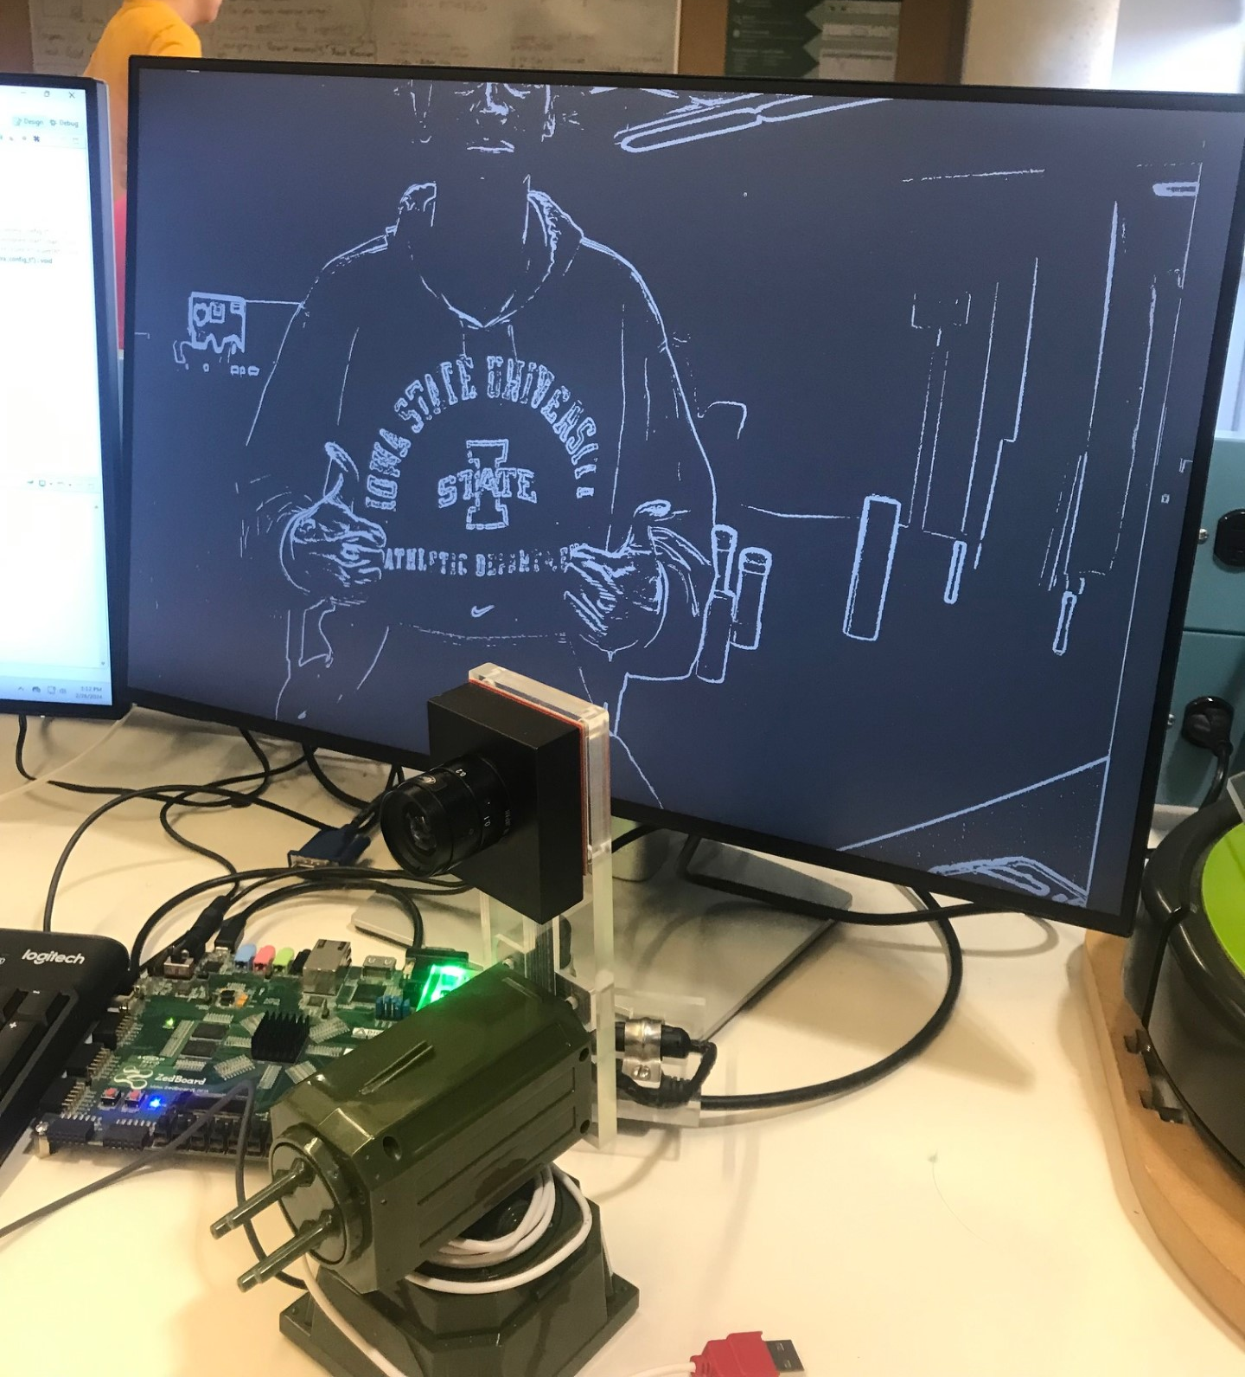
Areas of Interest
Edge detection/Sobel Filter
SW pipeline implementation only.
When in edge detect mode, apply sobel kernels to buffered luminescence values.
Set Cr & Cb values to 128 (Remove Color Information)
Looked into Vitis HLS tool to create sobel edge detection IP for hardware pipeline (Incomplete)

Slide 7
Lessons
Array math is very important especially dealing with image processing
Where you allocate your memory is also very important and knowing how much you would need for the application
Good to prototype a design in Matlab or similar language before you put it in an embedded application to save time

Slide 8
Questions?

